Slide 1
Greedy Algorithms

Slide 2
Greedy Algorithm
Greedy algorithms make the choice that looks best at the moment.
This locally optimal choice may lead to a globally optimal solution (i.e. an optimal solution to the entire problem).

Slide 3
When can we use Greedy algorithms?
We can use a greedy algorithm when the following are true:
The greedy choice property: A globally optimal solution can be arrived at by making a locally optimal (greedy) choice.
The optimal substructure property: The optimal solution contains within its optimal solutions to subproblems.

Slide 4
Designing Greedy Algorithms
Cast the optimization problem as one for which:
we make a choice and are left with only one subproblem to solve
Prove the GREEDY CHOICE
that there is always an optimal solution to the original problem that makes the greedy choice
Prove the OPTIMAL SUBSTRUCTURE:
the greedy choice + an optimal solution to the resulting subproblem leads to an optimal solution

Slide 5
Example: Making Change
Instance: amount (in cents) to return to customer
Problem: do this using fewest number of coins
Example:
Assume that we have an unlimited number of coins of various denominations:
1c (pennies), 5c (nickels), 10c (dimes), 25c (quarters), 1$ (loonies), 2$ (loonies)
Objective: Pay out a given sum $5.64 with the smallest number of coins possible.

Slide 6
The Coin Changing Problem
Assume that we have an unlimited number of coins of various denominations:
1c (pennies), 5c (nickels), 10c (dimes), 25c (quarters), 1$ (loonies), 2$ (loonies)
Objective: Pay out a given sum S with the smallest number of coins possible.
The greedy coin changing algorithm:
This is a Θ(m) algorithm where m = number of denominations.
while S > 0 do
c := value of the largest coin no larger than S;
num := S / c;
pay out num coins of value c;
S := S - num*c;

Slide 7
Example: Making Change
E.g.:
$5.64 = $2 +$2 + $1 + .25 + .25 + .10 + .01 + .01 + .01 +.01

Slide 8
Making Change – A big problem
Example 2: Coins are valued $.30, $.20, $.05, $.01
Does not have greedy-choice property, since $.40 is best made with two $.20’s, but the greedy solution will pick three coins (which ones?)

Slide 9
Knapsack Problem

Slide 10
Knapsack problem
A 1998 study of the Stony Brook University Algorithm Repository showed that, out of 75 algorithmic problems, the knapsack problem was the 18th most popular and the 4th most needed after kd-trees, suffix trees, and the bin packing problem

Slide 11
Knapsack Problem
Given a set of items, each with a mass and a value, determine the number of each item to include in a collection so that the total weight is less than or equal to a given limit and the total value is as large as possible.
It derives its name from the problem faced by someone who is constrained by a fixed-size knapsack and must fill it with the most valuable items.
Notes:
1. Items are indivisible: you either take an item or not. Solved with dynamic programming
2. Items are divisible: you can take any fraction of an item. Solved with a greedy algorithm

Slide 12
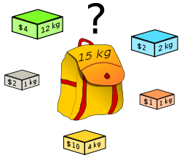
Fractional/ Partial Knapsack Problem
which boxes should be chosen to maximize the amount of money while still keeping the overall weight under or equal to 15 kg?
Answer: 3 yellow boxes and 3 grey boxes

Slide 13
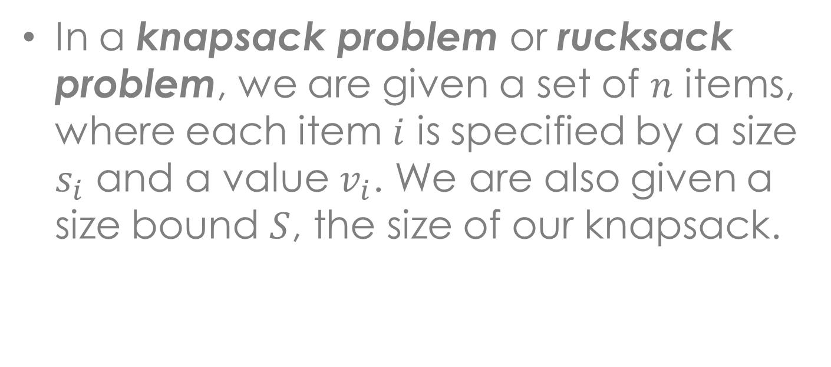
Knapsack Problem
Item # | Size | Value
1 | 1 | 8
2 | 3 | 6
3 | 5 | 5

Slide 14
Knapsack Problem
There are two versions of the problem:
0-1 Knapsack Problem
Fractional Knapsack Problem
Bounded Knapsack Problem
Unbounded Knapsack Problem
Notes:
1. Items are indivisible: you either take an item or not. Solved with dynamic programming
2. Items are divisible: you can take any fraction of an item. Solved with a greedy algorithm

